Slide 1
Careers in Pharmacy
Surinder Bhatia
Lead Pharmacist – Education & Training, Lister Hospital
Stacey Golding
Lead Pharmaceutical Adviser - Governance, NHS East and North Herts CCG
Notes:
Brief bio of my pharmacy career

Slide 2
Contents
Who are pharmacists?
Quick quiz-what do you know about medicines
Different sectors of the pharmacy profession
A career in pharmacy – university or apprenticeship

Slide 3
Pharmacists
Pharmacists are experts in medicines and their use.
There are 1000’s of medicines available.
We make sure patients get the right medicine, at the right dose, via the right route, at the right time.
The third largest healthcare profession in Great Britain.
Notes:
the right drug, right dose, right route, and right patient, at the right time

Slide 4
What do Pharmacist do?
Royal Pharmaceutical Society
https://www.rpharms.com/pharmacycareers
1 minute 20 second video

Slide 5
Medicines Quiz
Lets see how much you know about medicines
Have a look at the following pictures and options
After a quick show of hands - one student or teacher to reply on the chat box

Slide 6
Medicines Quiz- Question 1
What is this used for?
Pain
High temperature
Pain and High temperature

Slide 7
Medicines Quiz- Question 1
What is this used for? Answer
C. Pain and High temperature
Contains paracetamol – commonly used for children and adults

Slide 8
Did you know…
Paracetamol is one of the most commonly used medicines
BUT if you take too much, it can damage the liver
Pharmacists ensure you don’t take too much by giving you advice and asking about other medicines that you may be taking

Slide 9
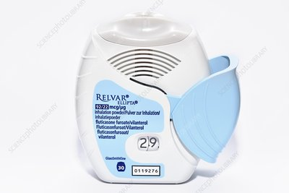
Medicines Quiz- Question 2
What is this ?
A hand held fan
An inhaler
A pill box

Slide 10
Medicines Quiz- Question 2
What is this ? Answer
B. An inhaler
Used for treatment of asthma and chronic obstructive pulmonary disease (COPD)

Slide 11
Did you know …
That the main cause of COPD is smoking
Community pharmacists run smoking cessation programmes to help people stop smoking
They supply nicotine replacement therapy
Provide support and advice

Slide 12
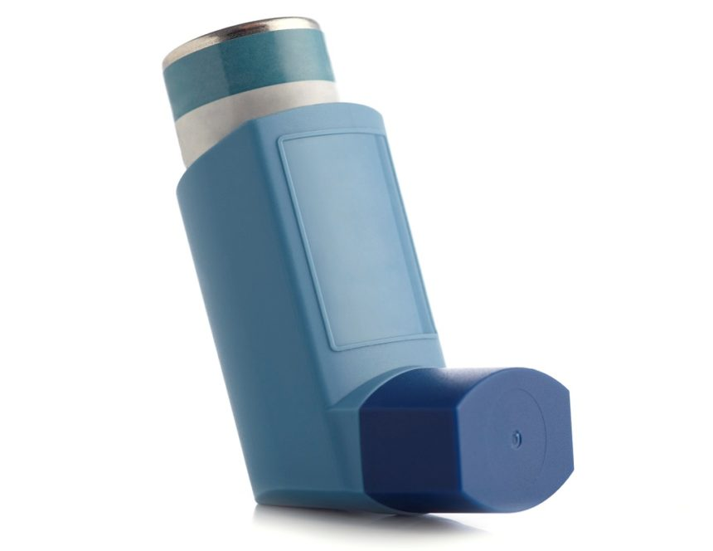
You may all have seen this inhaler before

Slide 13
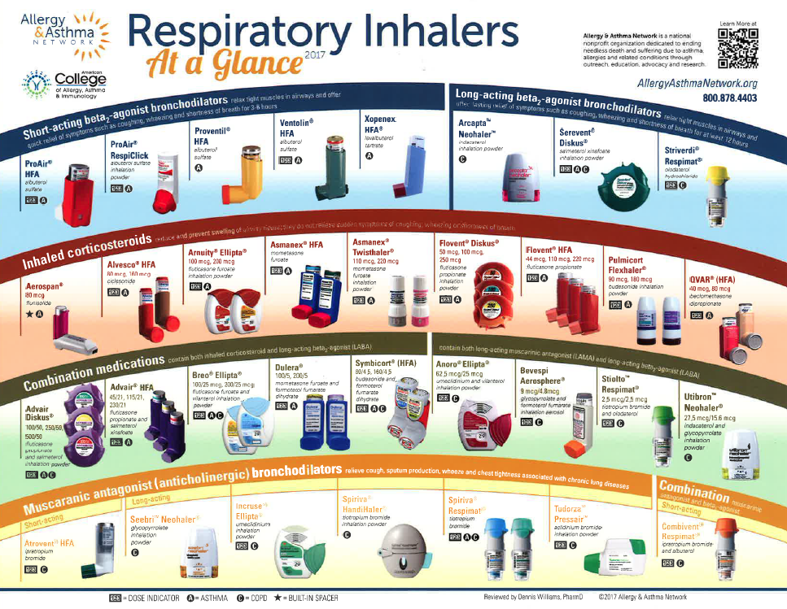
Did you know that there are over 100 different inhalers?
These are just some of the inhalers available.
Every device is used differently, so its important to choose the right one for the patient.
Pharmacists are involved in choosing the correct inhaler for a patient and teaching them how to use it.
This patient-centred care is really important so that the patient can get the most benefit from their treatment.

Slide 14
Medicines Quiz- Question 3
This is the bark of the willow tree – do you know what medicine was extracted from this?
Morphine
Insulin
Aspirin

Slide 15
Medicines Quiz- Question 3
This is the bark of the willow tree – do you know what medicines was extracted from this? Answer
C. Aspirin
Aspirin is used to relieve pain and inflammation and to thin the blood

Slide 16
Did you know …
Aspirin is no longer extracted from the bark of the willow tree
It is synthesised in labs by Pharmacists working in the pharmaceutical industry

Slide 17
Medicines Quiz- Question 4
What are these?
Permanent marker pens
Insulin injections
Steroid Injections

Slide 18
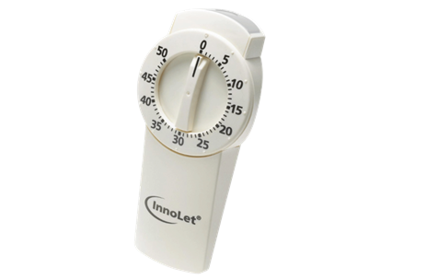
Medicines Quiz- Question 4
What are these? Answer
B. Insulin injections
Insulin is used to treat diabetes

Slide 19
Did you know…
Diabetes is linked to poor diet, lack of exercise and being overweight.
Community pharmacists give advice on how to stay healthy and prevent chronic diseases such as diabetes.

Slide 20
Medicines Quiz- Question 5
Are Antibiotics used to treat
Bacterial infections
Viral Infections
Both bacterial and viral infections

Slide 21
Medicines Quiz- Question 5
Answer
Antibiotics used to treat
Bacterial infections
This is why we cant use antibiotics to treat COVID19 infections.

Slide 22
Medicines Quiz- Question 6
Can you name the different ways in which medicines are delivered into the body?
- For example by mouth (tablets)

Slide 23
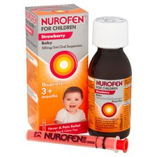
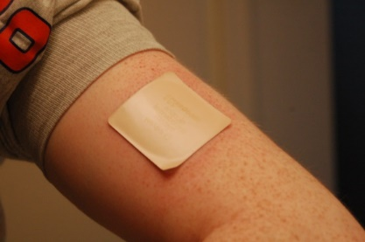
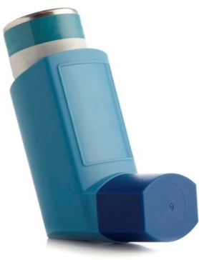
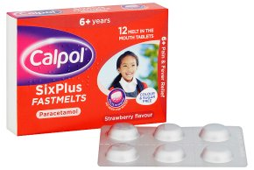
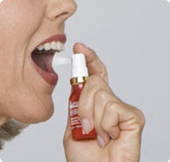
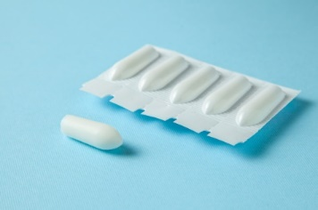
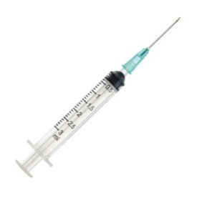
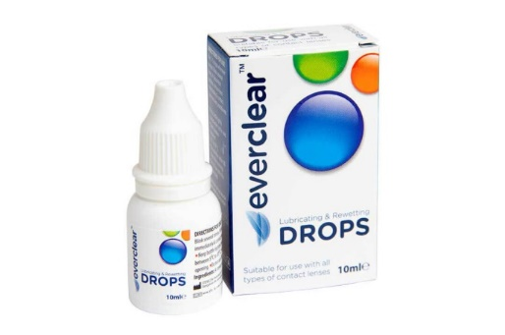
Medicines Quiz- Question 6
And more!

Slide 24
Medicines Quiz- Question 7
What is this? Is it
A. A prescription
B. Origami paper
C. Wrapping paper

Slide 25
Medicines Quiz- Question 7
What is this? Is it
Answer
A. A prescription
Only some medicines can be bought over the counter, most require a prescription from a doctor, dentist or prescribing pharmacist/nurse

